Slide 1

Design of system to generate photo realistic face images from textual description using GAN
BE-COMP-A
A17
Vikas Kushwaha (55)
Nikita Mahajan (56)
Rajeshwari Mishra (62)
Guide: Mrs. Shiwami Gupta

Slide 2
INTRODUCTION
Generating realistic images that semantically match given text descriptions is a challenging problem and has tremendous potential applications, such as image editing, video games, and computer-aided design.
Our project aims to generate realistic face image from description. This is achievable with the help of GAN (Generative adversarial network).

Slide 3
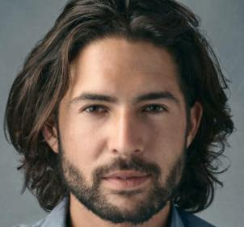
Example
Input required : Textual description (Eg:- Image caption )
Desired Output : Image (photo realistic face image in RGB colour format which matches corresponding textual description)
Example:- A fair man with beard.

Slide 4
Problem Definition
Synthesizing high-quality images from text descriptions is a challenging problem in computer vision and has many practical applications. Samples generated by existing text-to-image approaches can roughly reflect the meaning of the given descriptions, but they fail to contain necessary details and vivid object parts. We are motivated by the potential of automated face generation to impact and assist critical tasks such as criminal face reconstruction.

Slide 5
Project details
Domain: Intelligent System Design and Development.
Category: Application.
Type of project: Inhouse.
Application: Useful for Crime cases, engineers, scientist, designers. Designed for government and industry usage

Slide 6
Literature Survey
Title of the paper | Journal and year of publication | Summary of the paper | Gap identified
Text2FaceGAN: Face Generation from Fine Grained Textual Descriptions | 2019 IEEE Fifth International Conference on Multimedia Big Data (BigMM) | In this work they presented captions for the CelebA dataset to facilitate face synthesis from text. Then they used Generative Adversarial Network to learn the conditional multimodality in synthesis of face from captions | Improve the selection of the wrong image for the GAN-CLS algorithm. Currently, they randomly select images from the dataset as the wrong image .Explore better language models such as BERT, analyze and compare performance of other GAN architectures with their model for face generation from captions
AttnGAN: Fine-Grained Text to Image Generation with Attentional Generative Adversarial Networks | 2018 IEEE/CVF Conference on Computer Vision and Pattern Recognition | Attentional Generative Adversarial Network is proposed for fine-grained text-to-image synthesis which gives effective results for complex scenes. | To work on global coherent structure to eliminate the failure which could not be resolved by the current method.

Slide 7
Gaps
We should also focus on text irrelevant contents in the original image.
Focus on increasing the visual quality and resolution of generated images.
To improve the diversity of synthesized images and to stabilize the training of Conditional GAN introduced Conditioning Augmentation Technique.

Slide 8
Proposed Methodologies
Text to photo-realistic image synthesis with stacked Generative Adversarial Network.
Fine-grained text to image generation with Attentional Generative Adversarial Network.
Face Generation from Fine grained Textual Descriptions.
Deep Convolutional GAN (DCGAN) is a better option when compared with many other architectures like CGAN, CycleGAN, StarGAN, StyleGAN and many more.

Slide 9
Scope
Text-to-face generation has huge potentials in public safety domain.
It also has huge application potentials in art creation, computer-aided design, image searching and so on.
This technology can be used in many good things like criminal face reconstruction.
It has the ability to translate photograph across domains, such as day to night, summer to winter, and many more.

Slide 10
Tools
GPU which takes 12-16 sec to processes one image when compared with CPU which takes 2-5 min to processes a single image.
Another way is to use Google Colab is a free Jupyter notebook environment provided by Google where we can use free GPUs and TPUs(Tensor Processing Unit) which can solve all the issues.

Slide 11
Datasets
We are planning to use LFW (Labelled Faces in the Wild).A database of face photographs designed for studying the problem. The dataset contains more than 13,000 images of faces collected from the web. Each face has been labeled with the name of the person pictured. 1680 of the people pictured have two or more distinct photos in the data set.

Slide 12
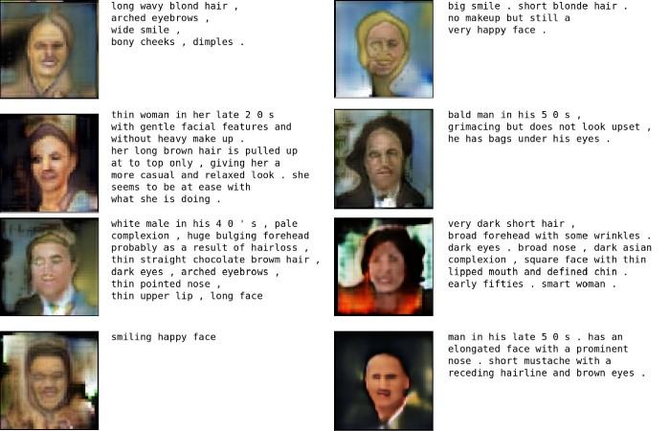
Expected Outcomes

Slide 13
Conclusion
We can assert that Text to Face Generation is a viable project with some very interesting applications. For instance, Text to face can help in identifying certain perpetrators / victims for the law agency from their description. It can also be use in applications where people can write their face description and can get their face generated.
The application can be used by both government as well as industry.

Slide 14
References
[1] Osaid Rehman Nasir, Shailesh Kumar Jha, Manraj Singh Grover, Yi Yu†, Ajit Kumar and Rajiv Ratn Shah, “Text2FaceGAN: Face Generation from Fine Grained Textual Descriptions” 2019 IEEE Fifth International Conference on Multimedia Big Data (BigMM).
[2] Han Zhang, Tao Xu, Hongsheng Li, Shaoting Zhang, Xiaogang Wang, Xiaolei Huang, Dimitris Metaxas in “StackGAN: Text to Photo-realistic Image Synthesis with Stacked Generative Adversarial Networks” 2017 IEEE International Conference on Computer Vision, pp. 5907–5915.
[3] Tao Xu, Pengchuan Zhang, Qiuyuan Huang, Han Zhang, Zhe Gan, Xiaolei Huang, Xiaodong He, “AttnGAN: Fine-Grained Text to Image Generation with Attentional Generative Adversarial Networks” 2018 IEEE/CVF Conference on Computer Vision and Pattern Recognition.
[4] ] Zizhao Zhang, Yuanpu Xie, and Lin Yang, “Photographic text-to-image synthesis with a hierarchically-nested adversarial network,” in Proceedings of the IEEE Conference on Computer Vision and Pattern Recognition, 2018, pp. 6199– 6208.
[5] Tero Karras, Samuli Laine, and Timo Aila, “A style-based generator architecture for generative adversarial networks,” in Proceedings of the IEEE Conference on Computer Vision and Pattern Recognition, 2019, pp. 4401–4410.
[6] Guojun Yin, Bin Liu , Lu Sheng, Nenghai Yu , Xiaogang Wang , Jing Shao, “Semantics Disentangling for Text-to-Image Generation” arXiv:1904.01480v1 [cs.CV] 2 Apr 2019.
[7] Micah Hodosh, Peter Young, and Julia Hockenmaier, “Framing image description as a ranking task: Data, models and evaluation metrics,” Journal of Artificial Intelligence Research, vol. 47, pp. 853–899, 2013.
[8] Zizhao Zhang, Yuanpu Xie, and Lin Yang, “Photographic text-to-image synthesis with a hierarchically-nested adversarial network,” in Proceedings of the IEEE Conference on Computer Vision and Pattern Recognition, 2018, pp. 6199– 6208.

Slide 15
Thank you !!

